Slide 1


Topic :- AI IN BLOCK CHAIN
Submitted By – Sri Somanjali
Registration No :- 12106452
Submitted By :- Ritin Anand
Registration No :- 12106458
Submitted By :- Sameer
Registration No :- 12215228

Slide 2
INDEX
Introduction
Requirement Gathering
Advantages of AI in Blockchain
3. Challenges and Limitations of AI in Blockchain
4. Implementation of CRYPTO Prediction
5. Conclusion

Slide 3
INTRODUCTION
AI Blockchain technology is a decentralized and distributed ledger that can be used to record transactions in a secure and transparent manner. AI, on the other hand, is a branch of computer science that deals with the development of algorithms that can perform tasks that normally require human intelligence, such as learning, reasoning, and problem-solving.
Artificial intelligence (AI) and blockchain are two innovative technologies that are revolutionizing the world in different ways. AI refers to the ability of machines to learn and perform tasks that typically require human intelligence, such as decision-making and problem-solving.
The combination of these two technologies has the potential to bring new solutions to various industries and problems.

Slide 4
Review and refine the plan
Identify potential challenges
It is to ensure that it is feasible and meets the business requirements. This may involve revisiting earlier steps in the requirement gathering process to make adjustments.
1
This include technical challenges, data privacy concerns, regulatory issues, or other challenges that could impact the success of the project.
3
2
Develop a project plan
4
Define success criteria
This plan should include timelines, milestones, and resources required to complete the project.
This could include accuracy of the AI model, reduction of costs or time, improved customer satisfaction, or other metrics that are relevant to the business problem being solved.

Slide 5
Identify the business problem
Determine data requirements
The first step is to identify the business problem that you are trying to solve using AI in blockchain. This helps what you should use, and what kind of results you are looking for.
It is important to ensure that the data is accurate, reliable, and relevant to the problem being solved. You will also need to determine how to access and store the data on the blockchain.
1
3
2
Define the scope
4
Determine technical
Define the scope of the project. This includes the data sources you will use, the blockchain platform you will use, and the specific AI algorithms you will apply..
This includes the hardware and software requirements, as well as any other technical considerations that need to be taken into account.

Slide 6
Advantages of AI in Blockchain
A. Smart Contracts: Smart contracts are self-executing contracts that can be programmed to execute automatically when certain conditions are met. They are a core feature of blockchain technology and can be used for a variety of purposes, such as asset transfer, voting, and supply chain management. AI can be integrated into smart contracts to make them more intelligent and flexible. For example, AI algorithms can be used to analyze data and trigger smart contract executions based on real-time events.
B. Fraud Detection: Fraud is a major concern in the blockchain industry, as it can compromise the security and integrity of the network. AI can be used to detect and prevent fraud by analyzing transaction data and identifying patterns of suspicious behaviour. Machine learning algorithms can also be used to learn from past incidents and improve fraud detection over time.

Slide 7
Advantages of AI in Blockchain
C. Identity Verification: Blockchain technology offers a decentralized and secure way of storing identity information. However, verifying the identity of users on the blockchain can be a challenge. AI can be used to verify the identity of users by analyzing biometric data, such as facial recognition and fingerprint scanning. This can help to prevent identity theft and other forms of fraud.
D. Supply Chain Management: Blockchain technology can be used to track the movement of goods and ensure their authenticity. AI can be used to analyze data from sensors and other sources to provide real-time information about the location and condition of goods. This can help to improve supply chain efficiency and reduce the risk of fraud and counterfeiting.

Slide 8
Advantages of AI in Blockchain
E. Decentralized Autonomous Organizations (DAOs): DAOs are organizations that are run by computer programs and operate on the blockchain. AI can be used to improve the decision-making capabilities of DAOs by analyzing data and providing insights into the best course of action. This can help to improve the efficiency and effectiveness of DAOs.

Slide 9
Challenges and Limitations In AI Blockchain
Data Quality
The data stored in the blockchain needs to be accurate, consistent, and complete . Also there is a risk of bias in the data, which can affect the decision-making process of AI.
Privacy and Security
While blockchain is known for its security features, it can still be vulnerable to attacks, blockchain is immutable, which means that it cannot be altered or deleted.
Scalability
As the number of transactions and data on the blockchain increases, the performance of the network may decrease. This can affect the speed of the AI algorithms and the overall efficiency of the system.
Integration
The integration of AI with blockchain requires specialized skills and expertise, which can be difficult to find.
Regulatory Challenges
Many countries have different regulations related to data privacy, security, and ownership. Therefore, it is essential to ensure that the implementation of AI blockchain complies with all the relevant regulations.

Slide 10
Challenges and Limitations In AI Blockchain
Energy Consumption
The process of mining and verifying transactions on a blockchain network requires a significant amount of computational power, which translates into high energy consumption.
Ethical and Social Implications
The use of AI blockchain technology raises several ethical and social implications, particularly around issues of accountability and transparency.
Adoption and Awareness
The adoption and awareness of AI blockchain technology is still relatively low, particularly among traditional industries that have been slow to adopt new technologies.
Lack of Standardization
This can result in a fragmented ecosystem that limits the scalability and adoption of AI on blockchain..
Governance and Consensus
there is a need for clear governance frameworks to ensure that the network is managed effectively and transparently.

Slide 11
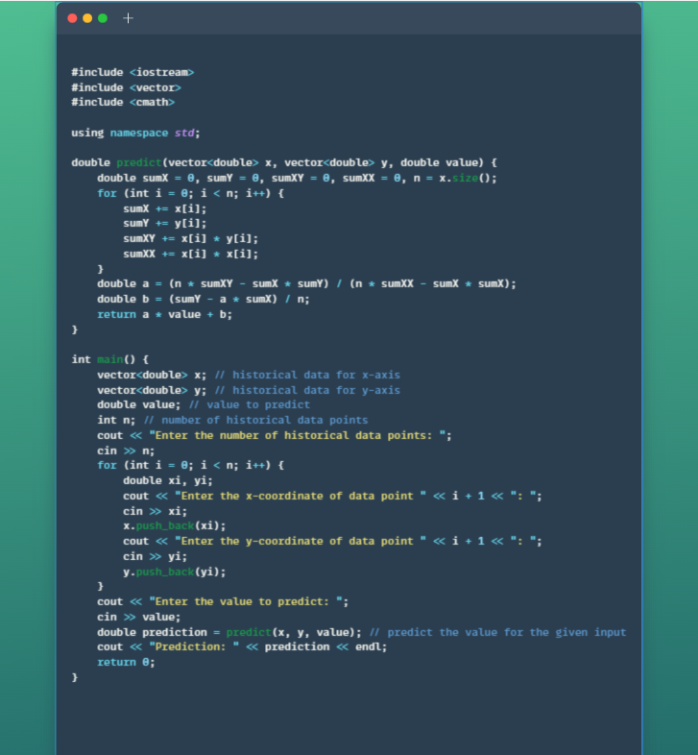
Implementation of AI in Blockchain
Implementation of CRYPTO Prediction
To implement a crypto prediction algorithm in C++, you will need to follow these steps:
Collect data: Collect historical data on the crypto you want to predict. This data should include information such as prices, trading volumes, and market capitalization.
Choose a prediction model: There are several prediction models you can choose from, such as time-series analysis, regression, and machine learning. Choose a model that suits your needs.
Train the model: Once you have chosen a model, you will need to train it using the historical data you have collected. This involves using the data to develop a set of rules or a mathematical formula that can be used to make predictions.
Test the model: Once you have trained the model, you should test it to see how well it performs. This involves using the model to make predictions on a set of data that has not been used for training.
Implement the model: Once you are satisfied with the performance of the model, you can implement it in C++. This involves writing the code that will take input data and use the model to make predictions.

Slide 12

Implementation of AI in Blockchain
In the code provided, the historical data represents the past values of a certain variable (in this case, a cryptocurrency) over time. The x vector represents the time stamps for each data point, and the y vector represents the corresponding value of the cryptocurrency at each time stamp.
For example, consider the x vector {1, 2, 3, 4, 5} and the y vector {100, 120, 130, 140, 150}. These vectors represent the historical data for a cryptocurrency, where each value in x represents a time stamp (e.g. day 1, day 2, day 3, etc.) and each value in y represents the value of the cryptocurrency at that time stamp (e.g. $100, $120, $130, etc.).
The predict function takes in these historical data points (x and y) as well as a new value value for which we want to predict the corresponding y value. The function uses linear regression to estimate the relationship between x and y, and then uses this relationship to predict the value of y for the given value of x

Slide 13
GITHUB LINK :-
Sri Somanjali :- https://github.com/srisomanjali18/AI-In-BlockChain.git
Sameer :- https://github.com/SSameer20/AI-in-Blockchain-Crypto-Price-Predictor.git
Ritin Anand :- https://github.com/ritin8040/AI-in-BlockChain

Slide 14

Conclusion
The combination of AI and blockchain presents numerous opportunities to transform various industries. While there are challenges and limitations to overcome, the benefits of these two technologies working together outweigh the negatives. Implementing a crypto protection code in C++ can help to secure data on the blockchain, making it more trustworthy and reliable. As the world continues to evolve, it's essential to keep an eye on AI in blockchain as it has the potential to bring significant changes to the way we do business.
AI and blockchain has the potential to transform various industries by providing secure, decentralized, and efficient solutions. However, there are still several challenges that need to be addressed before these technologies can be widely adopted. As the field of AI and blockchain continues to evolve, we can expect to see more innovative use cases and solutions in the future.

Slide 15
Thank you!

